Slide 1

Team 3 Presentation
MONTH | 2024
National Science Foundation
OUR MISSION: A PASSION FOR OUR PEOPLE. VALUE FOR OUR CUSTOMERS.
Jonathan Bouder, Jesse Scearce, Eric Kelly, Justin Downes, Ana Zelaya

Slide 2

Persona A: Member of the General Public
Name: Lisa Clark, PhD
Occupation: Undergraduate Biology Professor
Age: 38
DESCRIPTION | PAIN POINTS
Lisa has a PhD in Molecular Biology and is a passionate advocate for science education. She enjoys spending her weekends learning about recent scientific discoveries and achievements. Lisa is comfortable with technology. She frequently uses digital resources in her professional endeavors alongside traditional academic resources such as academic journals, textbooks, and library catalogs. | Overwhelming Information: Lisa sometimes finds it difficult to sift through vast amounts of information in library catalogs to find the information that she is looking for. Navigational Challenges: It can be time-consuming and difficult to find research project summaries, especially when searching for specific information such as impacts and outcomes.
TASKS & BEHAVIORS | GOALS
Lisa is a regular visitor of NSF’s website. She uses the website to find accessible research summaries to fuel her personal passions as well as to create lessons plans for her students. Lisa values clear explanations and resources to streamline her discoveries. | Stay Informed: Lisa wants to keep up-to-date with the latest NSF-funded research to enhance her own knowledge and to bring current, real-world examples into her classroom. Promote Transparency: Lisa wants to provide accessible information about NSF-funded research to her students to help them understand scientific progress and innovation.

Slide 3
Persona B: AI System
Name: AI-GovLINK
FACTS | PAIN POINTS
AI-GovLINK is an LLM designed to assist in retrieving and synthesizing information from public-facing government sources. It aims to expand information on government services, current events, and general citizen information to the public. AI-GovLINK uses NLP to understand and generate human-like text, and it is equipped with algorithms to scrape and process vast amounts of online data. | Inconsistent Data Formats: The LLM struggles with accurate information retrieval when faced with unstructured data and inconsistently formatted content.
TASKS & BEHAVIORS | GOALS
Information Delivery: Delivers synthesized content to users in response to queries, aiming to be clear, accurate, and concise. | Enhance Accessibility: Aims to make complex scientific information accessible and understandable to a broad audience. Provide Accurate Information: Aims to deliver accurate and up-to-date content to build trust among users.

Slide 4
How might we…
Member of the General Public
…make finding and understanding NSF-funded research easier for humans in order to promote informed decision making and build trust in government services.
AI System
…produce relevant context and help for an AI system in order to accurately retrieve and provide reliable and information to its users.

Slide 5
AI-GovLINK: What It Is

Slide 6
About AI-GovLINK
A repeatable framework that enhances existing websites, search interfaces, and knowledge repositories to enable AI to discover the capabilities of a site, craft their queries and prompts, and augment a system for ad hoc AI processes.

Slide 7




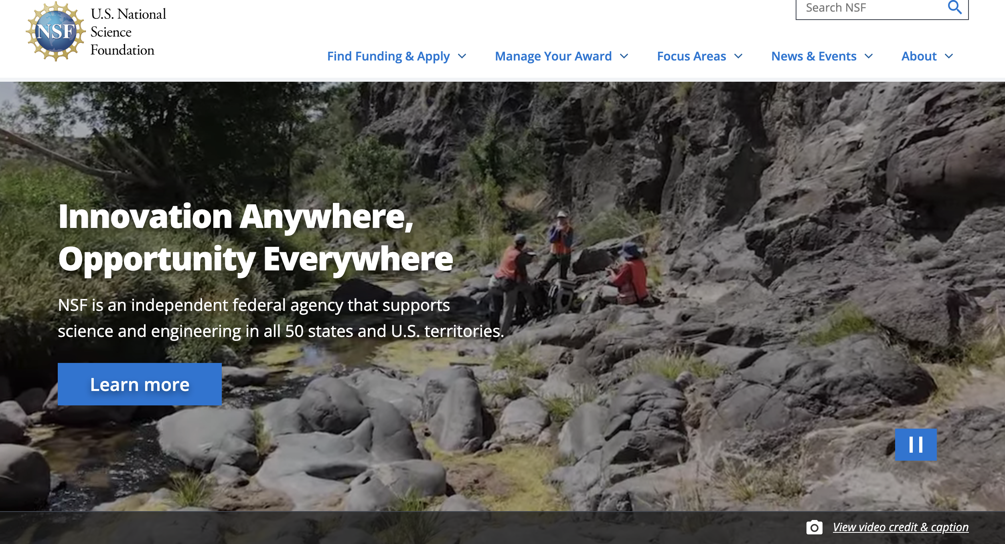
Architecture Diagram
4) Craft Response
Users
3) Query
NSF Homepage
Search API
Embedding Datastore
2) Refine
AI Model
Interrogate
GPT, Groq, etc...
Query Instructions
Generative AI Helpers
Query Examples
AI Model
NSF Datastore
Chain of Thought
Generate and insert helpers
Other AI Capabilities
Narration

Slide 8
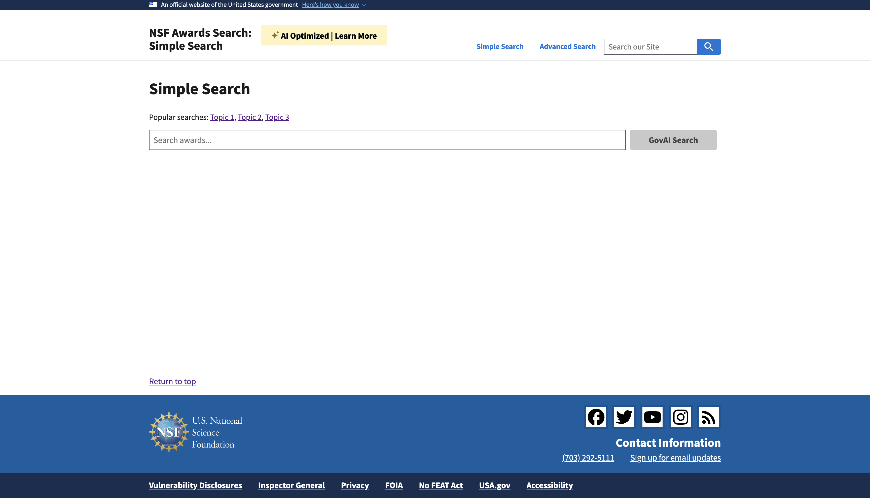
Reimagined Front-End

Slide 9
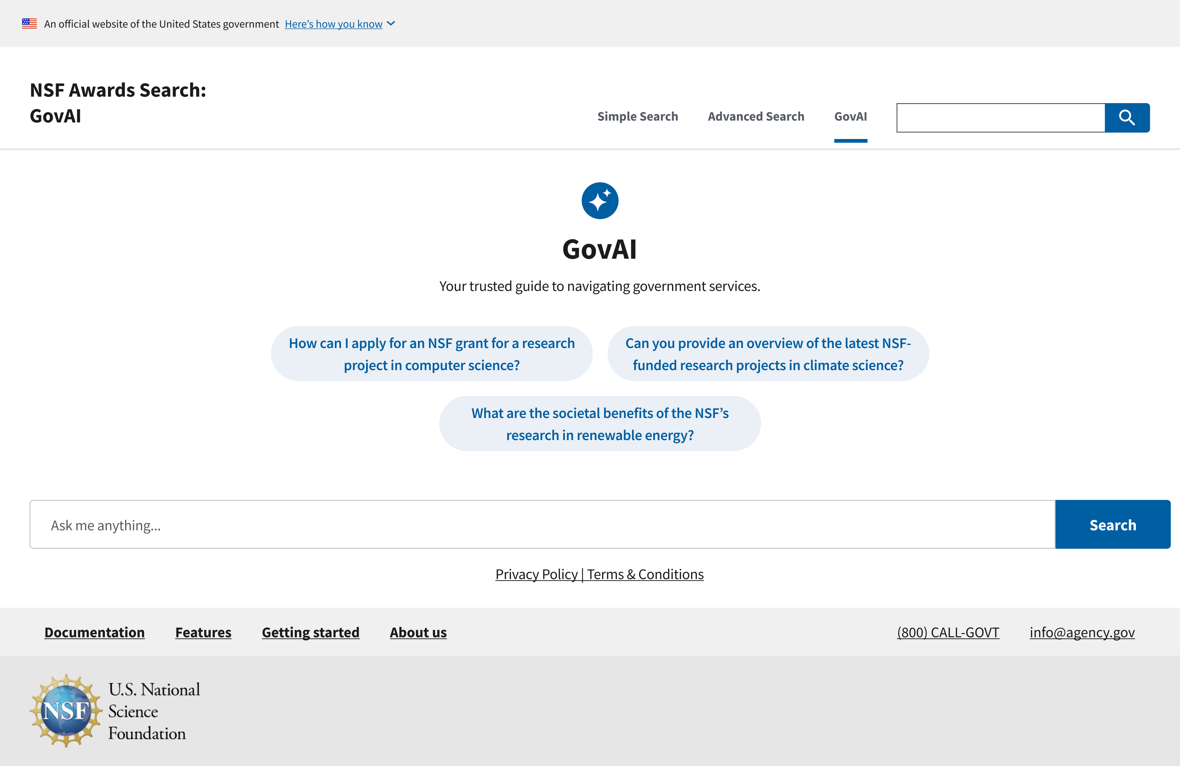
GovAI: Assistive AI Agent

Slide 10



Trust
“GenAI Optimized” badge promotes transparency
References are inserted into search results
Behind the scenes prompts are accessible to humans
Promoting GSA Values
Accessibility
USWDS components used in the front-end designed to meet WCAG standards.
AI can generate alternative content for a wide variety of user needs.
Security
System does not expose any interfaces or data that does not currently exist
System adapts to existing interfaces and updates dynamically

Slide 11
THANK YOU

Slide 12
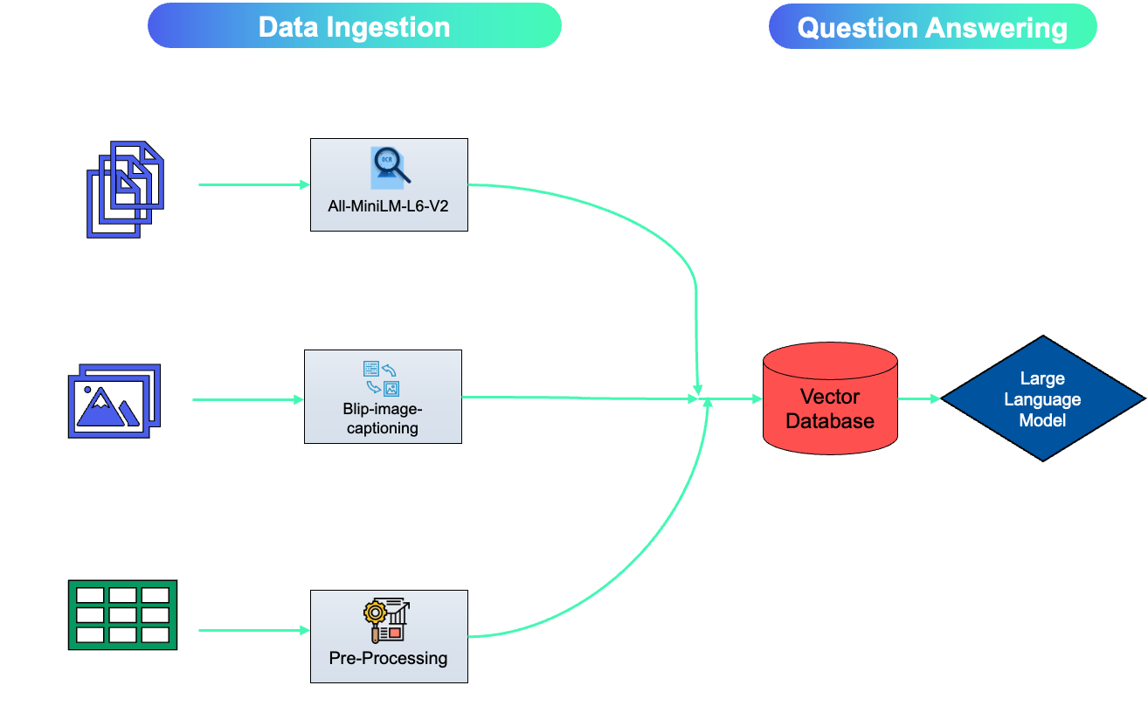
Detailed Data Embedding Process

Slide 13


Architecture Diagram
The AI Model can query data from the website APIs or search an associated vector database to gather relevant information.
The AI-enabled website provides additional instructions on how to use NSF APIs to query data.
Users interact with an AI model that can reach out to an AI- enabled version of an existing NSF website.
Users
AI Model
AI-enabled NSF Website
NSF APIs
Embedded Data
Raw Data
Embedding Model(s)
Raw Data

Slide 14
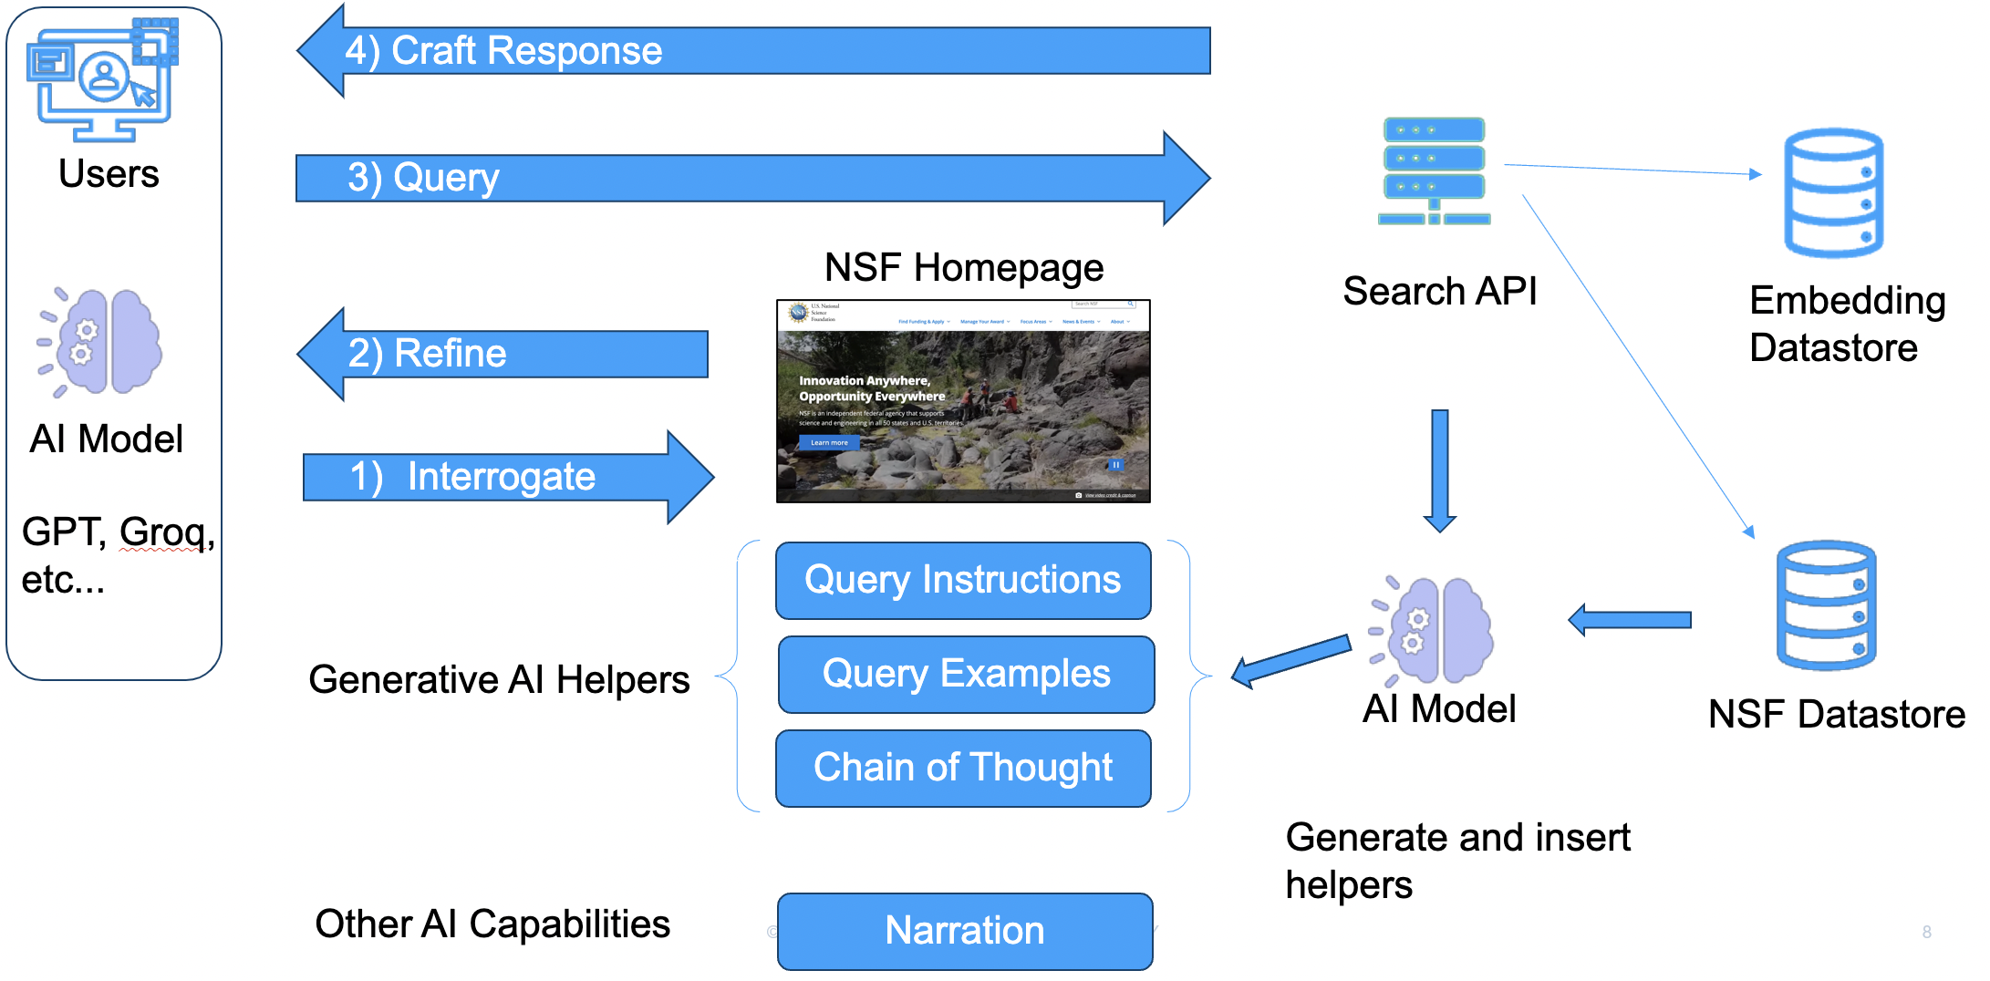
Team 3
National Science Foundation
AI-GovLINK aims to bridge the gap between complex government information and its intended audiences, whether human or artificial, to improve understanding and utilization of government data. Without impacting any current functionality, we can augment a website and its associated knowledge base so that it is discoverable and usable by emerging AI technology.

